Slide 1
Fáilte/Welcome!
PPES JF Orientation meeting, 17 September 2024
Prof Elaine Moriarty
  Academic Director, PPES programme

Slide 2
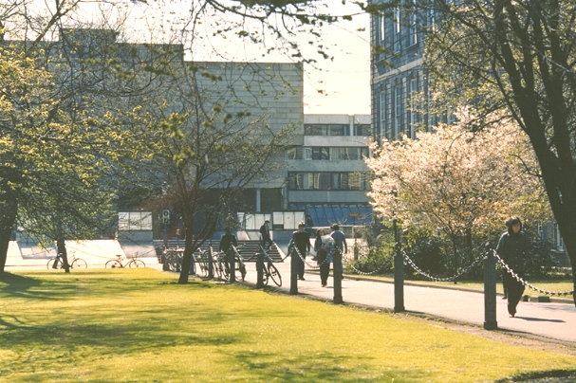
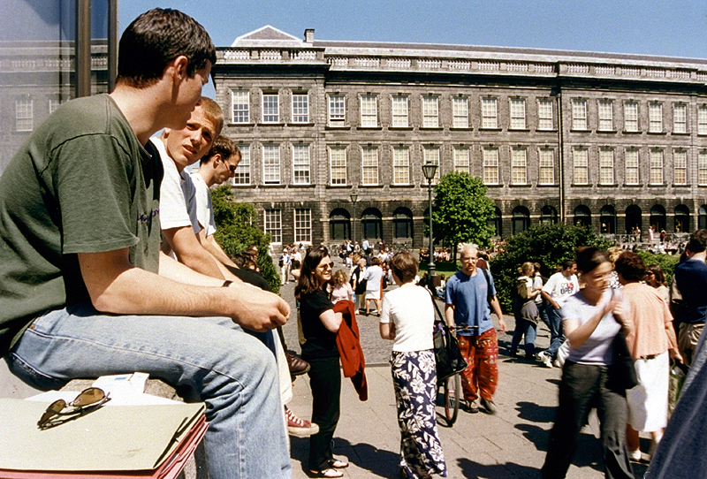


Trinity College… Founded in 1592
A University of Global Consequence
Leading Irish Research University
Global Recognition
Ranked 1st in Ireland and 101st in the World
(QS World University Ranking)

Slide 3
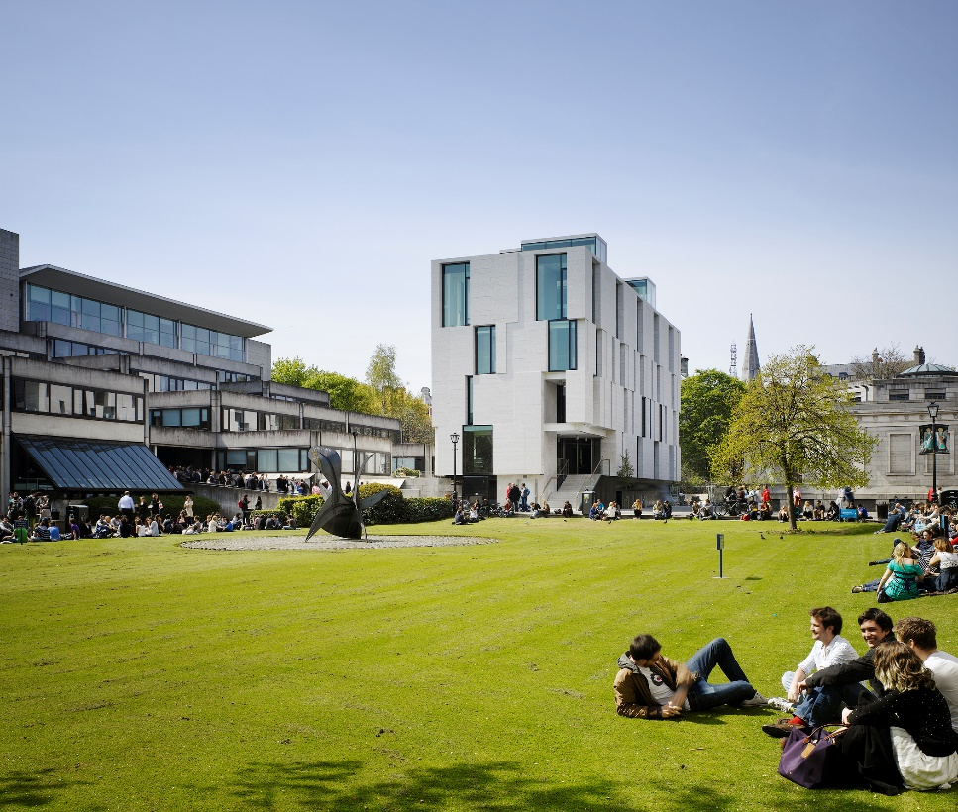
PPES - Philosophy, Political Science, Economics and Sociology
Philosophy | 5th floor, Arts Building
Political Science | 4th floor, 2-3 College Green (between Starbucks and Costa on Dame St)
Economics | 3rd floor, Arts Building
Sociology | 3rd floor, 2-3 College Green (between Starbucks and Costa on Dame St)
School of Social Sciences and Philosophy

Slide 4
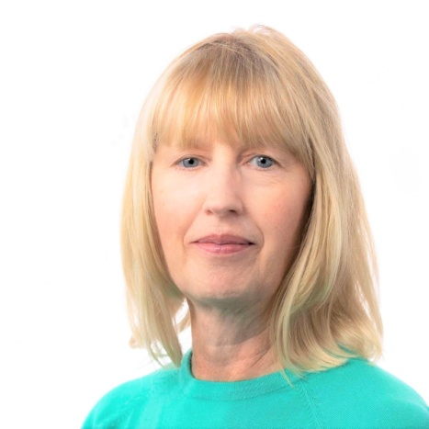

PPES Programme Administration
Office: Room 3023, Level 3, Arts Building
Administrator: Martina Ní Chochláin
Email: ppes@tcd.ie (giving your student number)
  Open every day (8-12.45 and 2-3.15)
  email/call by in person
Martina Ní Chochláin
Annual/Re-assessment Progression & Publication of Results Timetable PPES Programme Regulations | Management of Programme Handbook/Web Site Transcripts of Results General PPES Queries – If I can’t help you personally, I’ll know someone who can!

Slide 5
Academic Calendar Week | Week beginning | 2024/25 Academic Year Calendar |  | Term / Semester
 |  | UG continuing years / PG all years | UG new first years
1 | 26-Aug-24 | Reassessment * (Semesters 1 & 2 of 2023/24) |  | ←Michaelmas Term begins/Semester 1 begins
2 | 02-Sep-24 | Orientation (Postgraduate, Visiting & Erasmus); Marking/Results
3 | 09-Sep-24 | Teaching and Learning |  | ←Michaelmas teaching term begins
4 | 16-Sep-24 | Teaching and Learning | Orientation (JF UG)
5 | 23-Sep-24 | Teaching and Learning | Teaching and Learning
6 | 30-Sep-24 | Teaching and Learning | Teaching and Learning
7 | 07-Oct-24 | Teaching and Learning | Teaching and Learning
8 | 14-Oct-24 | Teaching and Learning | Teaching and Learning
9 | 21-Oct-24 | Study/Review | Study/Review
10 | 28-Oct-24 | Teaching and Learning (Monday, Public Holiday) | Teaching and Learning (Monday, Public Holiday)
11 | 05-Nov-24 | Teaching and Learning | Teaching and Learning
12 | 11-Nov-24 | Teaching and Learning | Teaching and Learning
13 | 18-Nov-24 | Teaching and Learning | Teaching and Learning
14 | 25-Nov-24 | Teaching and Learning | Teaching and Learning
15 | 02-Dec-24 | Revision *¹ | Revision * ¹
16 | 09-Dec-24 | Assessment * ¹ | Assessment *¹ ~ | ←Michaelmas term ends Sunday 17 December 2023/Semester 1 ends
17 | 18-Dec-24 | Christmas Period - College closed 24 December 2024 to 1 January 2025 inclusive | Christmas Period - College closed 24 December 2025 to 1 January 2025 inclusive
18 | 23-Dec-24
19 | 30-Dec-24
20 | 06-Jan-25 | Foundation Scholarship Examinations ^ |  | ←Hilary Term begins/Semester 2 begins
21 | 13-Jan-25 | Marking/Results | Marking/Results
22 | 20-Jan-25 | Teaching and Learning | Teaching and Learning | ←Hilary teaching term begins
23 | 27-Jan-25 | Teaching and Learning | Teaching and Learning
24 | 03-Feb-24 | Teaching and Learning (Monday, Public Holiday) | Teaching and Learning (Monday, Public Holiday)
25 | 10-Feb-255 | Teaching and Learning | Teaching and Learning
26 | 17-Feb-25 | Teaching and Learning | Teaching and Learning
27 | 24-Feb-25 | Teaching and Learning | Teaching and Learning
28 | 03-Mar-25 | Study/Review | Study/Review
29 | 10-Mar-25 | Teaching and Learning | Teaching and Learning
30 | 17-Mar-25 | Teaching and Learning (Monday, Public Holiday) | Teaching and Learning (Monday, Public Holiday)
31 | 24-Mar-25 | Teaching and Learning | Teaching and Learning
32 | 31-Mar-25 | Teaching and Learning (Monday, Easter Monday) | Teaching and Learning (Monday, Easter Monday)
33 | 07-Apr-25 | Teaching and Learning | Teaching and Learning
34 | 14-Apr-25 | Revision (Friday, Good Friday) | Revision (Friday, Good Friday) | ←Hilary Term ends Sunday 21 April 2024
35 | 21-Apr-25 | Assessment *² (Monday, Easter Monday) | Assessment *² (Monday, Easter Monday) | ←Trinity Term begins
36 | 28-Apr-25 | Trinity Week (Monday, Trinity Monday) *² | Trinity Week (Monday, Trinity Monday) *²
37 | 05-May-25 | Marking/Results (Monday, Public Holiday) | Marking/Results (Monday, Public Holiday)
38 | 12-May-25 | Marking/Results | Marking/Results
39 | 19-May-25 | Marking/Results | Marking/Results
Academic Calendar Week | Week beginning | 2024/25 Academic Year Calendar |  | Term / Semester

Slide 6
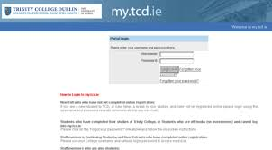
Your college timetable
my.tcd.ie
Your lectures and tutorials/seminars will be available on my.tcd.ie
Along with your module choices, it also contains information on lecture and seminar venues
It may include optional courses that are available on learning about plagiarism and academic integrity; navigating the library; engaging with student development

Slide 7
What is the Trinity PPES programme?
https://www.tcd.ie/ssp/undergraduate/ppes/
Philosophy
Sociology
Political Science
Economics

Slide 8
What you will study
Overview
1st Year
(Junior
Fresh)
2nd Year
(Senior
Fresh)
3rd Year
(Junior
Sophister)
4th Year
(Senior Sophister)
60 ECTS
60 ECTS
60 ECTS
60 ECTS
Introduction to
all four disciplines
Key foundational skills of your chosen discipline(s)
Specialisation allowing to choose areas of interest within 2nd year discipline(s)
Opportunity to study abroad
Specialisation in your chosen discipline(s)
Capstone project

Slide 9
1st Year
(Junior
Fresh)
2nd Year
(Senior
Fresh)
3rd Year
(Junior
Sophister)
4th Year
(Senior Sophister)
In the Junior Fresh (first) year, you will take 60 ECTS worth of compulsory modules from within all four subjects:
Economics (including Mathematics and Statistics)
Philosophy
Political Science
Sociology

Slide 10
PPES Junior Fresh – Year 1
Six compulsory modules from all four subjects:
  Philosophy
  Political Science
  Economics
  Sociology
-Lots of complementarity
Philosophy
Central problems in Philosophy History of Philosophy
Politics
Introduction to Political Science
Economics
Introduction to Economics Mathematics and Statistics
Sociology
Introduction to Sociology

Slide 11
1st Year
(Junior
Fresh)
2nd Year
(Senior
Fresh)
3rd Year
(Junior
Sophister)
4th Year
(Senior Sophister)
In Senior Fresh (second) year students take 60 ECTS from two or three of the four subjects:
20 ECTS in Subject 1, 20 ECTS in Subject 2 and 20 ECTS in Subject 3, dropping one of the four subjects taken in Junior Fresh year or
20 ECTS in Subject 1, 20 ECTS in Subject 2, 10 ECTS from any of the available modules within the programme structure and 10 ECTS of Trinity Electives, dropping two of the four subjects taken in Junior Fresh year, or
40 ECTS in Subject 1 and 20 ECTS in Subject 2, dropping two of the four subjects taken in Junior Fresh year.
40 ECTS in Subject 1, 10 ECTS from any of the available modules within the programme structure and 10 ECTS of Trinity Electives
Note: In order to continue with a Single Honor, students must take 40 ECTS in that subject in the Senior Fresh year.

Slide 12
1st Year
(Junior
Fresh)
2nd Year
(Senior
Fresh)
3rd Year
(Junior
Sophister)
4th Year
(Senior Sophister)
Be mindful of
mandatory modules for specific degree pathways (see PPES handbook)
prerequisites for 3rd/4th year subjects (see PPES handbook) and their implications for your pathway opportunities
Study abroad prep: Application process for going abroad in the 3rd year.
See PPES Handbook for details on pathways, modules and prereqs!

Slide 13
1st Year
(Junior
Fresh)
2nd Year
(Senior
Fresh)
3rd Year
(Junior
Sophister)
4th Year
(Senior Sophister)
In Junior and Senior Sophister year, students can pursue the following:
Single Honor in Philosophy; Political Science; Economics; Sociology
Joint Honor in Philosophy and Political Science; Philosophy and Economics; Philosophy and Sociology; Political Science and Economics; Political Science and Sociology; Sociology and Economics
Major/Minor
  Major Economics (Minor Philosophy or Minor Political Science or Minor Sociology)
  Major Philosophy (Minor Political Science or Minor Economics or Minor Sociology)
  Major Political Science (Minor Philosophy or Minor Economics or Minor Sociology)
  Major Sociology (Minor Philosophy or Minor Political Science or Minor Economics)

Slide 14
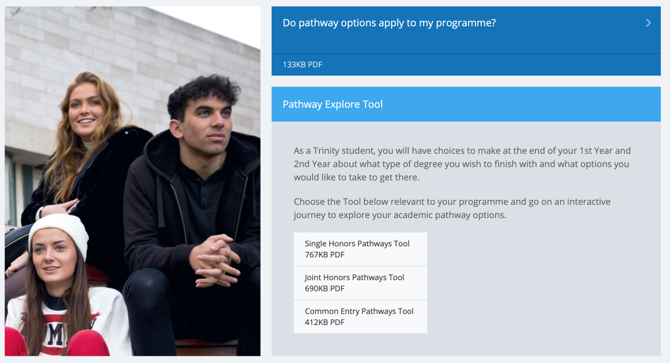
Pathway Explore Tool
https://www.tcd.ie/courses/undergraduate/your-trinity-pathways/

Slide 15

The Trinity Experience
https://www.tcd.ie/students/clubs-societies/
Wider student life is important, and PPES provides plenty of scope for engagement in a wide range of activities.
50 sports clubs, 120 societies.
Some societies seem particularly suited to PPES Students
DUBES – Dublin University Business & Economic Society | Political Science Society | Social Studies Society
AIESEC | Foresight | Enterprise Trinity
Upstart | Mature Students Society

Slide 16

We are here to help!
PPES website www.tcd.ie/ppes
PPES Handbook
PPES Administration and Director
Your Module Lecturers
Module Teaching Assistants
Your College Tutor
Student Learning Development
Mathematics Help Room

Slide 17
Important PPES Rules (1)
Attend your lectures and tutorials!
Lectures and tutorials are compulsory!
Students with significant level of absenteeism can be deemed non-satisfactory (“NS”) and prevented from sitting final examinations!
Some tests may take place during Michaelmas and Hilary Terms
(e.g. in modules with continuous assessment).
Lecture, test and exam scheduling is done by central College and students are generally informed at the same time as academic staff

Slide 18
Important PPES Rules (2)
Keep updated and communicate properly
Check your college emails daily!
Only use your official college email address (…@tcd.ie)
We will not response to private email accounts!
Be polite and respectful when writing emails to college staff
Write concise emails that state clearly your concern
Always provide your course and student ID in emails!
Configure a signature including your course name and student ID.

Slide 19
Important PPES Rules (3)
What to do if …
… you are ill for tests and/or examinations?
Absences are excused only with a medical certificate or equivalent (communicate with/via your College Tutor), need to do this immediately.
Absence is not the same as getting zero. If you fail to turn up to an exam you need to explain it formally to the college through your tutor.
The assumption is that if you sit an exam then you were healthy. Typically, it is not possible to claim illness after an exam.

Slide 20
Important PPES Rules (4)
What to do if …
… you are unable to submit an assignment on schedule?
Contact your tutor and the lecturer concerned, preferably before the deadline.
… you are unable to attend a mandatory class?
Contact your tutor and the lecturer concerned, preferably before the class is taking place.

Slide 21
Making your voices heard
PPES: student representative on the programme committee.
Students’ Union: class reps who meet with individual Department Heads on a regular basis.
Module evaluations by students: at the end of Hilary and Michaelmas terms. (http://www.tcd.ie/ssp/undergraduate/student-evaluations/YouSaid_WeDid.php)
Each year you will be invited to partake in a Course Evaluation.
Problems with a module? If possible, bring it up with the module lecturer in the first instance.
Individual/personal problems? – discuss with your College Tutor/Counselling service/Student 2 Student (S2S).

Slide 22
Next week
Two hours of lectures in each of the modules.
In the first lecture the requirements and rules of the module will be explained, so make sure you attend.
Usually, no seminars or tutorials in week 1 (but check module descriptions)
  Seminar/tutorial groups assigned by College.
  You can only request a change of tutorial group in exceptional circumstances by contacting the relevant departmental office (not the Course Office).
Design a study/work plan – you must keep up with all required coursework

Slide 23
Next steps
Check your college email regularly (communication from the Course Office will be via your TCD email address only).
Check mytcd.ie regularly for all timetable, venue, exams related information.
Contact your College Tutor.
Contact Student 2 Student (S2S).
Get to know your classmates. Be inclusive and create new networks.
Join at least 1 society/club – Be brave!

Slide 24
And finally….
Enjoy your studies on the PPES Programme at Trinity College Dublin!

